Slide 1
CS 61C: Great Ideas in Computer Architecture (Machine Structures) Single-Cycle CPU Datapath Control Part 1
Instructors:
Krste Asanovic & Vladimir Stojanovic
http://inst.eecs.berkeley.edu/~cs61c/

Slide 2
Review
Timing constraints for Finite State Machines
Setup time, Hold Time, Clock to Q time
Use muxes to select among inputs
S control bits selects from 2S inputs
Each input can be n-bits wide, indep of S
Can implement muxes hierarchically
ALU can be implemented using a mux
Coupled with basic block elements

Slide 3
How to design Adder/Subtractor?
Truth-table, then determine canonical form, then minimize and implement as we’ve seen before
Look at breaking the problem down into smaller pieces that we can cascade or hierarchically layer

Slide 4
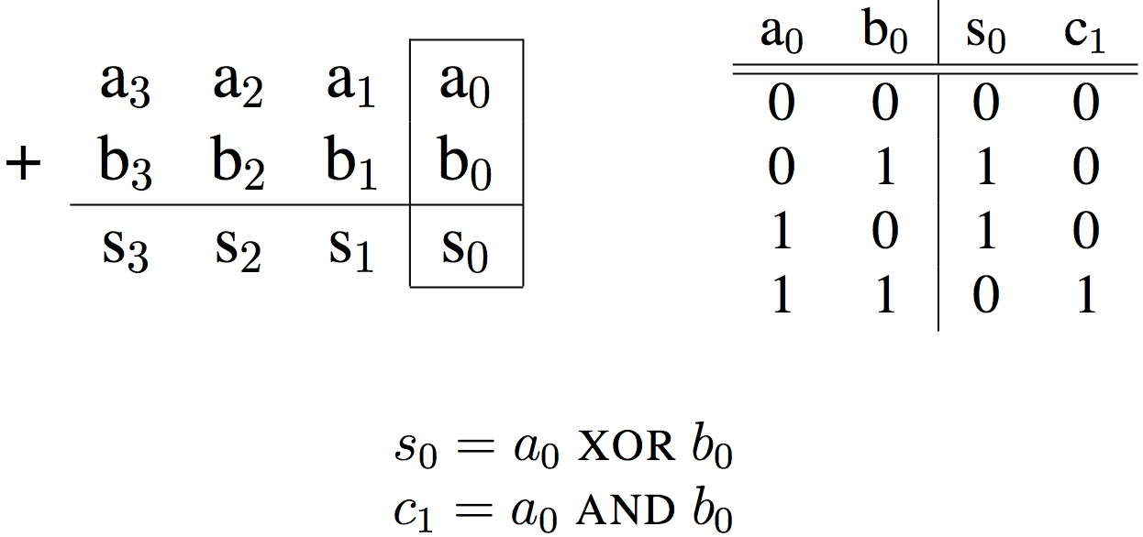
Adder/Subtractor – One-bit adder LSB…

Slide 5
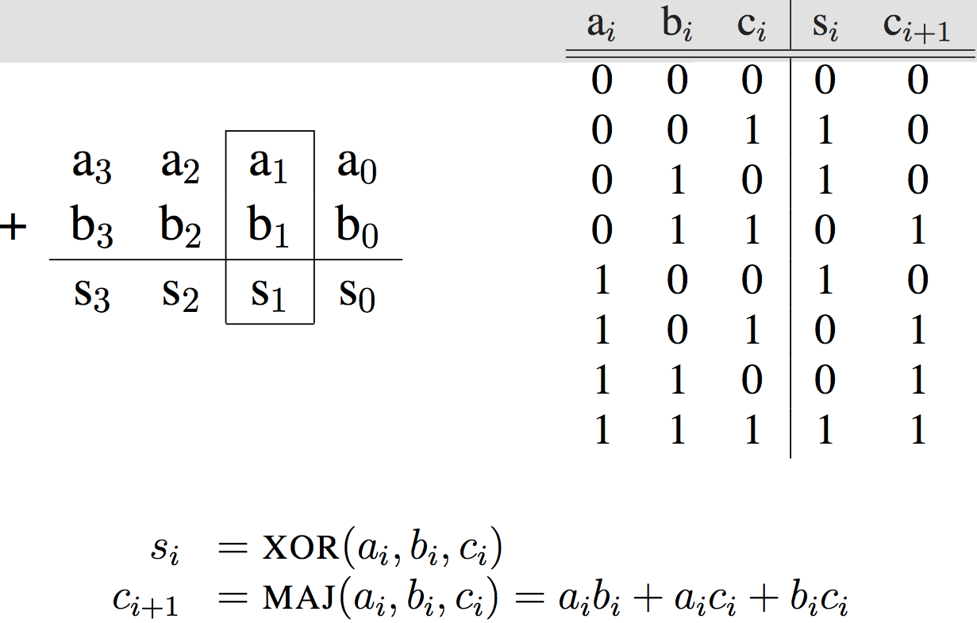
Adder/Subtractor – One-bit adder (1/2)…

Slide 6
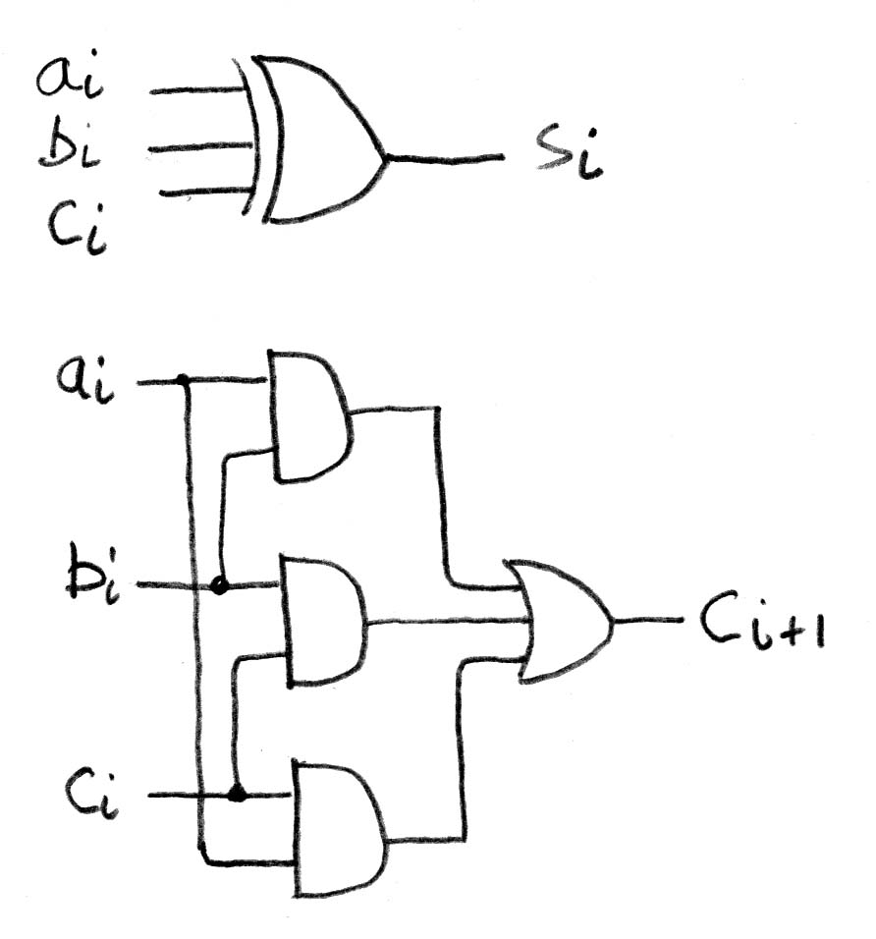
Adder/Subtractor – One-bit adder (2/2)

Slide 7
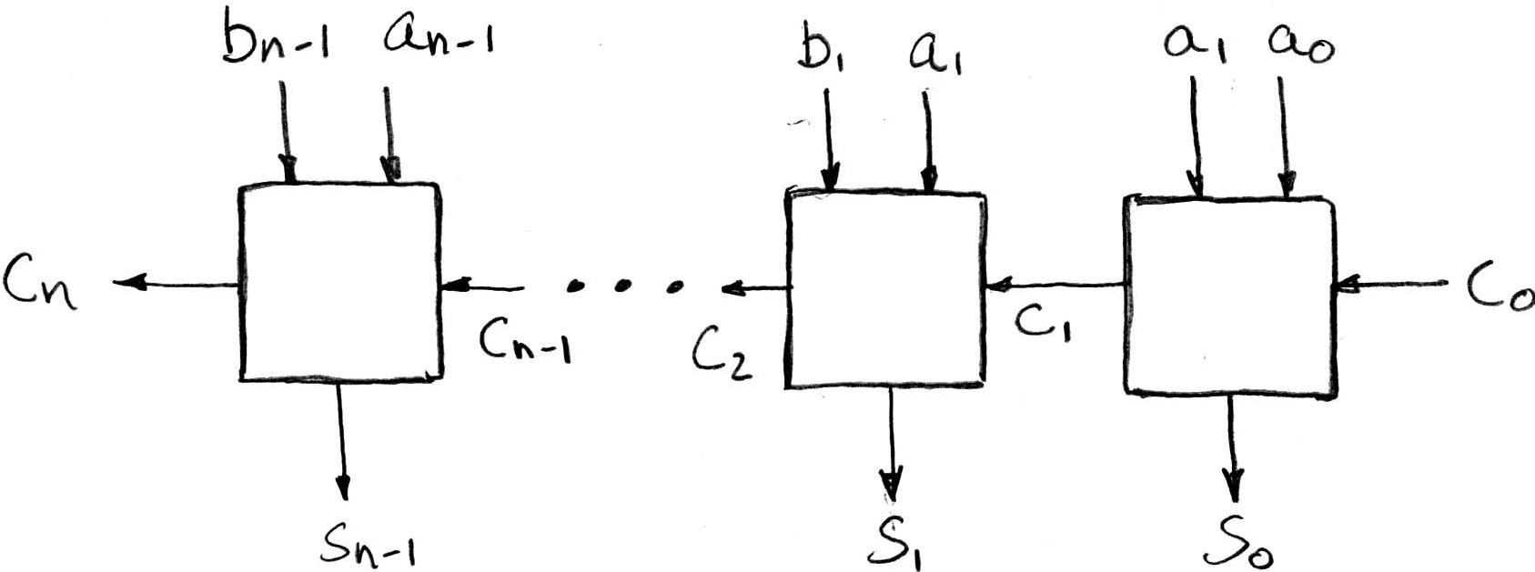
N 1-bit adders ⇒ 1 N-bit adder
b₀
+
+
+
What about overflow?
Overflow = c_{n}?

Slide 8
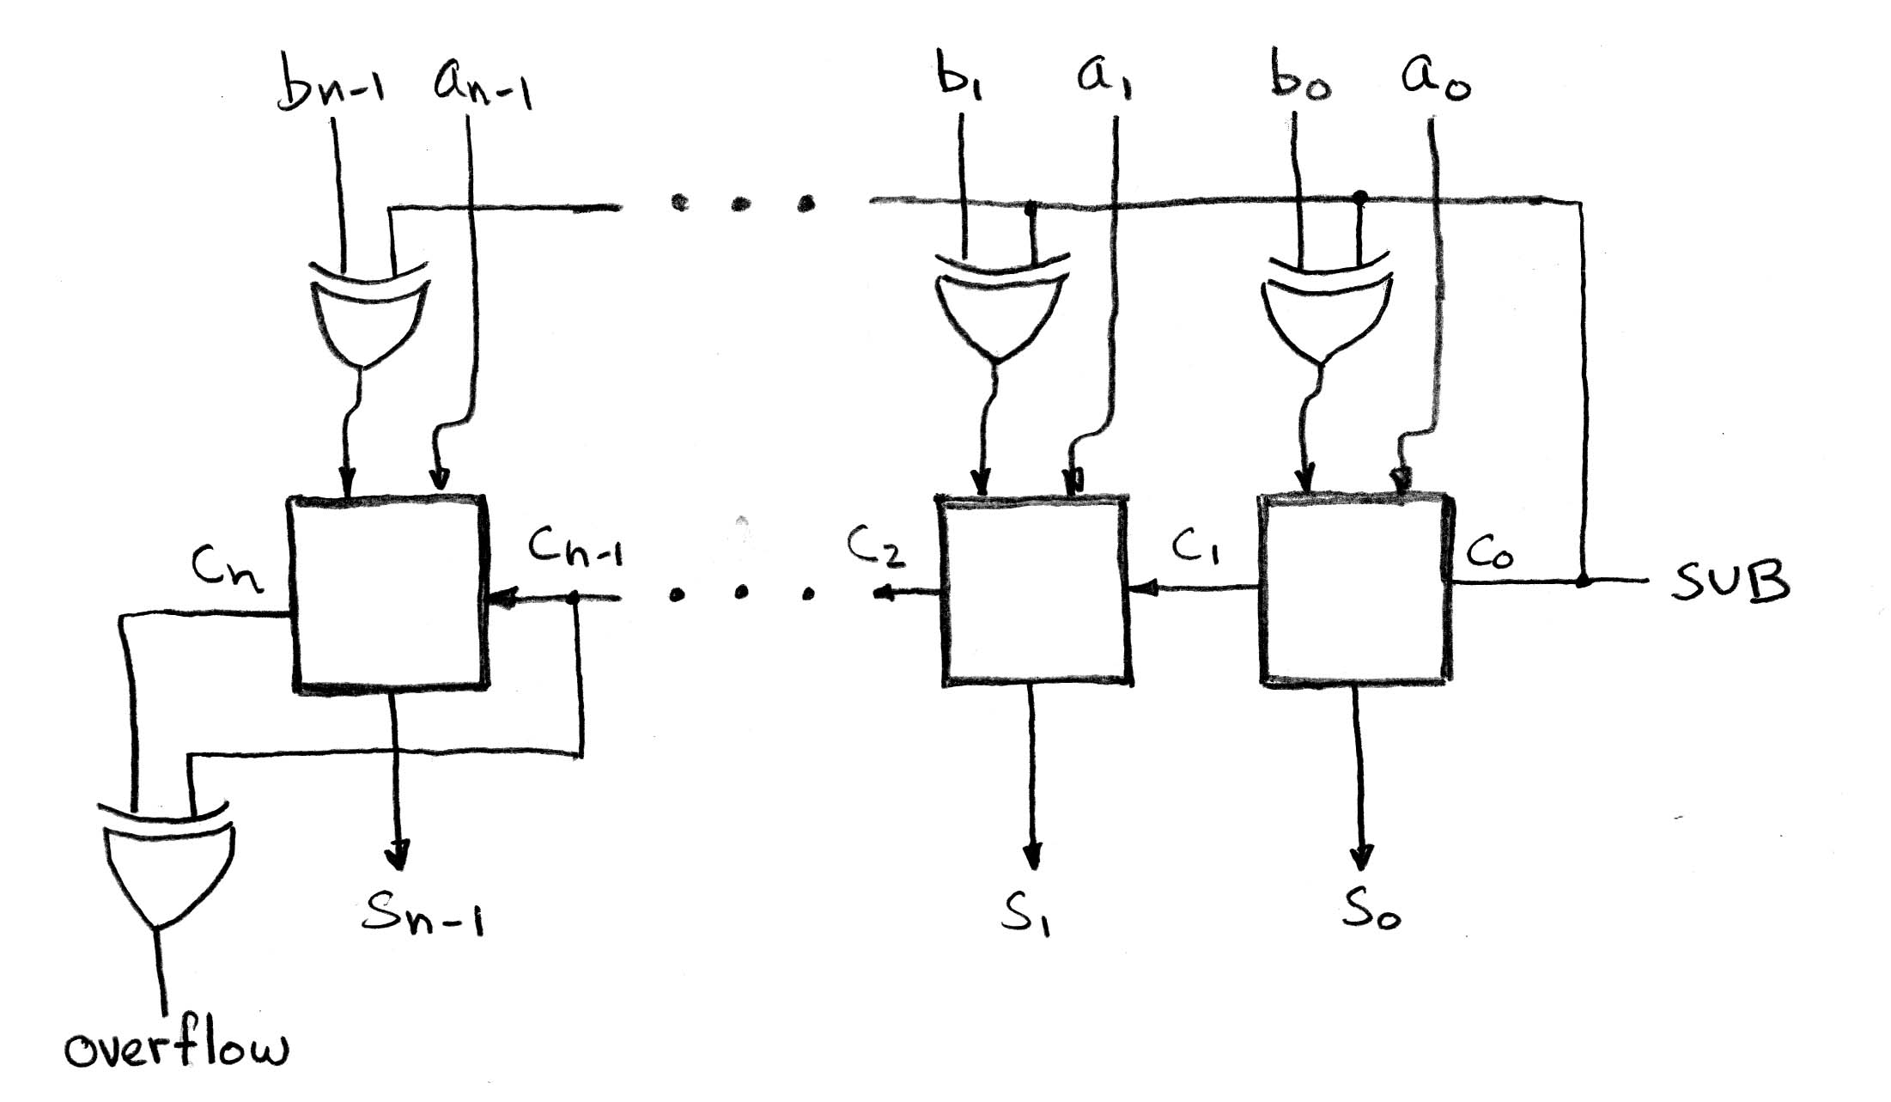
Extremely Clever Subtractor
+
+
+
x | y | XOR(x,y)
0 | 0 | 0
0 | 1 | 1
1 | 0 | 1
1 | 1 | 0
XOR serves as conditional inverter!

Slide 9
Components of a Computer
Memory
Processor
Input
Enable?
Read/Write
Control
Program
Datapath
Address
Bytes
PC
Registers
Write Data
Data
Arithmetic & Logic Unit
(ALU)
ReadData
Output
Processor-Memory Interface
I/O-Memory Interfaces

Slide 10
The CPU
Processor (CPU): the active part of the computer that does all the work (data manipulation and decision-making)
Datapath: portion of the processor that contains hardware necessary to perform operations required by the processor (the brawn)
Control: portion of the processor (also in hardware) that tells the datapath what needs to be done (the brain)

Slide 11
Five Stages of Instruction Execution
Stage 1: Instruction Fetch
Stage 2: Instruction Decode
Stage 3: ALU (Arithmetic-Logic Unit)
Stage 4: Memory Access
Stage 5: Register Write

Slide 12
Stages of Execution (1/5)
There is a wide variety of MIPS instructions: so what general steps do they have in common?
Stage 1: Instruction Fetch
no matter what the instruction, the 32-bit instruction word must first be fetched from memory (the cache-memory hierarchy)
also, this is where we Increment PC (that is, PC = PC + 4, to point to the next instruction: byte addressing so + 4)

Slide 13
Stages of Execution (2/5)
Stage 2: Instruction Decode
upon fetching the instruction, we next gather data from the fields (decode all necessary instruction data)
first, read the opcode to determine instruction type and field lengths
second, read in data from all necessary registers
for add, read two registers
for addi, read one register
for jal, no reads necessary

Slide 14
Stages of Execution (3/5)
Stage 3: ALU (Arithmetic-Logic Unit)
the real work of most instructions is done here: arithmetic (+, -, *, /), shifting, logic (&, |), comparisons (slt)
what about loads and stores?
lw $t0, 40($t1)
the address we are accessing in memory = the value in $t1 PLUS the value 40
so we do this addition in this stage

Slide 15
Stages of Execution (4/5)
Stage 4: Memory Access
actually only the load and store instructions do anything during this stage; the others remain idle during this stage or skip it all together
since these instructions have a unique step, we need this extra stage to account for them
as a result of the cache system, this stage is expected to be fast

Slide 16
Stages of Execution (5/5)
Stage 5: Register Write
most instructions write the result of some computation into a register
examples: arithmetic, logical, shifts, loads, slt
what about stores, branches, jumps?
don’t write anything into a register at the end
these remain idle during this fifth stage or skip it all together

Slide 17
Administrivia

Slide 18
Stages of Execution on Datapath
rd
PC
instruction
memory
registers
rs
Data
memory
rt
ALU
+4
imm
2. Decode/
Register
Read
3. Execute
4. Memory
1. Instruction
Fetch
5. Register
Write
Notes:
missing: multiplexors or “data selectors” – where should they be in this picture and why?
also missing – opcode for control of what operations to perform
state elements vs combinational ones – combinational given the same input will always produce the same output – out depends only on the current input

Slide 19
Datapath Walkthroughs (1/3)
add $r3,$r1,$r2 # r3 = r1+r2
Stage 1: fetch this instruction, increment PC
Stage 2: decode to determine it is an add, then read registers $r1 and $r2
Stage 3: add the two values retrieved in Stage 2
Stage 4: idle (nothing to write to memory)
Stage 5: write result of Stage 3 into register $r3

Slide 20
Example: add Instruction
add r3, r1, r2
reg[1] + reg[2]
reg[1]
3
PC
instruction
memory
registers
1
Data
memory
reg[2]
ALU
2
+4
imm

Slide 21
Datapath Walkthroughs (2/3)
slti $r3,$r1,17 # if (r1 <17 ) r3 = 1 else r3 = 0
Stage 1: fetch this instruction, increment PC
Stage 2: decode to determine it is an slti, then read register $r1
Stage 3: compare value retrieved in Stage 2 with the integer 17
Stage 4: idle
Stage 5: write the result of Stage 3 (1 if reg source was less than signed immediate, 0 otherwise) into register $r3

Slide 22
Example: slti Instruction
slti r3, r1, 17
reg[1] < 17?
reg[1]
x
instruction
memory
PC
1
registers
Data
memory
ALU
3
+4
imm
17

Slide 23
Datapath Walkthroughs (3/3)
sw $r3,17($r1) # Mem[r1+17]=r3
Stage 1: fetch this instruction, increment PC
Stage 2: decode to determine it is a sw, then read registers $r1 and $r3
Stage 3: add 17 to value in register $r1 (retrieved in Stage 2) to compute address
Stage 4: write value in register $r3 (retrieved in Stage 2) into memory address computed in Stage 3
Stage 5: idle (nothing to write into a register)

Slide 24
Example: sw Instruction
sw r3, 17(r1)
reg[1] + 17
reg[1]
x
instruction
memory
registers
PC
1
Data
memory
reg[3]
ALU
3
+4
imm
17
MEM[r1+17] = r3

Slide 25
Why Five Stages? (1/2)
Could we have a different number of stages?
Yes, other ISAs have different natural number of stages
Why does MIPS have five if instructions tend to idle for at least one stage?
Five stages are the union of all the operations needed by all the instructions.
One instruction uses all five stages: the load

Slide 26
Why Five Stages? (2/2)
lw $r3,17($r1) # r3=Mem[r1+17]
Stage 1: fetch this instruction, increment PC
Stage 2: decode to determine it is a lw, then read register $r1
Stage 3: add 17 to value in register $r1 (retrieved in Stage 2)
Stage 4: read value from memory address computed in Stage 3
Stage 5: write value read in Stage 4 into register $r3

Slide 27
Example: lw Instruction
lw r3, 17(r1)
reg[1] + 17
reg[1]
x
instruction
memory
PC
1
registers
Data
memory
ALU
3
+4
imm
17
MEM[r1+17]

Slide 28
Datapath and Control
Datapath designed to support data transfers required by instructions
Controller causes correct transfers to happen
rd
PC
instruction
memory
registers
rs
Data
memory
rt
ALU
+4
imm
opcode, funct
Controller

Slide 29
In the News
At ISSCC 2015 in San Francisco yesterday, latest IBM mainframe chip details
z13 designed in 22nm SOI technology with seventeen metal layers, 4 billion transistors/chip
8 cores/chip, with 2MB L2 cache, 64MB L3 cache, and 480MB L4 cache.
5GHz clock rate, 6 instructions per cycle, 2 threads/core
Up to 24 processor chips in shared memory node

Slide 30
















Register Now:
Berkeley – IAP
Workshop on the
Future of Cloud
Technologies
Friday,
February 27,
2015
Soda Hall
Berkeley, CA
POSTERS: $500 Prizes for Best Undergrad & Best Grad
CAREER FAIR: During Lunch/Breaks, Bring Your Resume
http://www.industry-academia.org/event-berkeley-cloud-workshop.html
Quotes from the MIT Workshop
“I was excited by the turnout and the breadth of the speakers.”- Prof. Matei Zaharia, CTO Databricks
“In a nutshell, the workshop is an excellent opportunity for students, faculties and people from industry to share ideas.” – Po-An Tsai, PhD Student, MIT CSAIL, Best Poster Award

Slide 31
Processor Design: 5 steps
Step 1: Analyze instruction set to determine datapath requirements
Meaning of each instruction is given by register transfers
Datapath must include storage element for ISA registers
Datapath must support each register transfer
Step 2: Select set of datapath components & establish clock methodology
Step 3: Assemble datapath components that meet the requirements
Step 4: Analyze implementation of each instruction to determine setting of control points that realizes the register transfer
Step 5: Assemble the control logic

Slide 32
The MIPS Instruction Formats
All MIPS instructions are 32 bits long. 3 formats:
R-type
I-type
J-type
The different fields are:
op: operation (“opcode”) of the instruction
rs, rt, rd: the source and destination register specifiers
shamt: shift amount
funct: selects the variant of the operation in the “op” field
address / immediate: address offset or immediate value
target address: target address of jump instruction
31
26
21
16
11
6
0
op
rs
rt
rd
shamt
funct
6 bits
5 bits
5 bits
5 bits
5 bits
6 bits
31
26
21
16
0
op
rs
rt
address/immediate
6 bits
5 bits
5 bits
16 bits
31
26
0
op
target address
6 bits
26 bits
Notes:
One of the most important thing you need to know before you start designing a processor is how the instructions look like.
Or in more technical term, you need to know the instruction format. One good thing about the MIPS instruction set is that it is very simple.
First of all, all MIPS instructions are 32 bits long and there are only three instruction formats: (a) R-type, (b) I-type, and (c) J-type.
The different fields of the R-type instructions are:
(a) OP specifies the operation of the instruction.
(b) Rs, Rt, and Rd are the source and destination register specifiers.
(c) Shamt specifies the amount you need to shift for the shift instructions.
(d) Funct selects the variant of the operation specified in the “op” field.
For the I-type instruction, bits 0 to 15 are used as an immediate field. I will show you how this immediate field is used differently by different instructions.
Finally for the J-type instruction, bits 0 to 25 become the target address of the jump.
+3 = 10 min. (X:50)

Slide 33
The MIPS-lite Subset
ADDU and SUBU
addu rd,rs,rt
subu rd,rs,rt
OR Immediate:
ori rt,rs,imm16
LOAD and STORE Word
lw rt,rs,imm16
sw rt,rs,imm16
BRANCH:
beq rs,rt,imm16
31
26
21
16
11
6
0
op
rs
rt
rd
shamt
funct
6 bits
5 bits
5 bits
5 bits
5 bits
6 bits
31
26
21
16
0
op
rs
rt
immediate
6 bits
5 bits
5 bits
16 bits
31
26
21
16
0
op
rs
rt
immediate
6 bits
5 bits
5 bits
16 bits
31
26
21
16
0
op
rs
rt
immediate
6 bits
5 bits
5 bits
16 bits
Notes:
In today’s lecture, I will show you how to implement the following subset of MIPS instructions: add, subtract, or immediate, load, store, branch, and the jump instruction.
The Add and Subtract instructions use the R format. The Op together with the Func fields together specified all the different kinds of add and subtract instructions.
Rs and Rt specifies the source registers. And the Rd field specifies the destination register.
The Or immediate instruction uses the I format. It only uses one source register, Rs. The other operand comes from the immediate field. The Rt field is used to specified the destination register. (Note that dest is the Rt field!)
Both the load and store instructions use the I format and both add the Rs and the immediate filed together to from the memory address.
The difference is that the load instruction will load the data from memory into Rt while the store instruction will store the data in Rt into the memory.
The branch on equal instruction also uses the I format. Here Rs and Rt are used to specified the registers we need to compare.
If these two registers are equal, we will branch to a location offset by the immediate field.
Finally, the jump instruction uses the J format and always causes the program to jump to a memory location specified in the address field.
I know I went over this rather quickly and you may have missed something. But don’t worry, this is just an overview. You will keep seeing these (point to the format) all day today.
start at 7min

Slide 34
Register Transfer Level (RTL)
Colloquially called “Register Transfer Language”
RTL gives the meaning of the instructions
All start by fetching the instruction itself
{op , rs , rt , rd , shamt , funct} ← MEM[ PC ]
{op , rs , rt , Imm16} ← MEM[ PC ]
Inst Register Transfers
ADDU R[rd] ← R[rs] + R[rt]; PC ← PC + 4
SUBU R[rd] ← R[rs] – R[rt]; PC ← PC + 4
ORI R[rt] ← R[rs] | zero_ext(Imm16); PC ← PC + 4
LOAD R[rt] ← MEM[ R[rs] + sign_ext(Imm16)]; PC ← PC + 4
STORE MEM[ R[rs] + sign_ext(Imm16) ] ← R[rt]; PC ← PC + 4
BEQ if ( R[rs] == R[rt] ) PC ← PC + 4 + {sign_ext(Imm16), 2’b00}
else PC ← PC + 4
Notes:
RTL – like most programming langs:
precise and unambiguous
must be debugged
code can be checked automatically for certain properties – type checking, check against abstract state machine, etc.
TOOLS – simulator, processor, tape out
Verilog is a popular RTL (used in 150 for FPGA development)
10 mins

Slide 35
Step 1: Requirements of the Instruction Set
Memory (MEM)
Instructions & data (will use one for each)
Registers (R: 32, 32-bit wide registers)
Read RS
Read RT
Write RT or RD
Program Counter (PC)
Extender (sign/zero extend)
Add/Sub/OR/etc unit for operation on register(s) or extended immediate (ALU)
Add 4 (+ maybe extended immediate) to PC
Compare registers?
Notes:
15 mins

Slide 36
Step 2: Components of the Datapath
Combinational Elements
Storage Elements + Clocking Methodology
Building Blocks
OP
CarryIn
Select
A
A
32
A
32
Adder
Sum
32
Result
32
MUX
Y
ALU
32
32
B
CarryOut
B
B
32
32
32
Adder
Multiplexer
ALU
Notes:
Adder – why no overflow detect?
Multiplexer – talk about specs – width of data multiplexed, # of select bits

Slide 37
ALU Needs for MIPS-lite + Rest of MIPS
Addition, subtraction, logical OR, ==:
ADDU R[rd] = R[rs] + R[rt]; ...
SUBU R[rd] = R[rs] – R[rt]; ...
ORI R[rt] = R[rs] | zero_ext(Imm16)...
BEQ if ( R[rs] == R[rt] )...
Test to see if output == 0 for any ALU operation gives == test. How?
P&H also adds AND, Set Less Than (1 if A < B, 0 otherwise)
ALU follows Chapter 5
Notes:
20 mins

Slide 38
Storage Element: Idealized Memory
Write Enable
Address
“Magic” Memory
One input bus: Data In
One output bus: Data Out
Memory word is found by:
For Read: Address selects the word to put on Data Out
For Write: Set Write Enable = 1: address selects the memory word to be written via the Data In bus
Clock input (CLK)
CLK input is a factor ONLY during write operation
During read operation, behaves as a combinational logic block: Address valid ⇒ Data Out valid after “access time”
Data In
DataOut
32
32
Clk
Notes:
The last storage element you will need for the datapath is the idealized memory to store your data and instructions.
This idealized memory block has just one input bus (DataIn) and one output bus (DataOut).
When Write Enable is 0, the address selects the memory word to put on the Data Out bus.
When Write Enable is 1, the address selects the memory word to be written via the DataIn bus at the next clock tick.
Once again, the clock input is a factor ONLY during the write operation.
During read operation, it behaves as a combinational logic block.
That is if you put a valid value on the address lines, the output bus DataOut will become valid after the access time of the memory.
+2 = 35 min. (Y:15)

Slide 39
Storage Element: Register (Building Block)
Write Enable
Similar to D Flip Flop except
N-bit input and output
Write Enable input
Write Enable:
Negated (or deasserted) (0): Data Out will not change
Asserted (1): Data Out will become Data In on positive edge of clock
Data In
Data Out
N
N
clk
Notes:
As far as storage elements are concerned, we will need a N-bit register that is similar to the D flip-flop I showed you in class.
The significant difference here is that the register will have a Write Enable input.
That is the content of the register will NOT be updated if Write Enable is not asserted (0).
The content is updated at the clock tick ONLY if the Write Enable signal is asserted (1).
Show how to build Register from FF
25 mins

Slide 40
Storage Element: Register File
RW
RA
RB
Write Enable
5
5
5
Register File consists of 32 registers:
Two 32-bit output busses:
busA and busB
One 32-bit input bus: busW
Register is selected by:
RA (number) selects the register to put on busA (data)
RB (number) selects the register to put on busB (data)
RW (number) selects the register to be written via busW (data) when Write Enable is 1
Clock input (clk)
Clk input is a factor ONLY during write operation
During read operation, behaves as a combinational logic block:
RA or RB valid ⇒ busA or busB valid after “access time.”
busA
busW
32 x 32-bit
Registers
32
32
busB
Clk
32
Notes:
We will also need a register file that consists of 32 32-bit registers with two output busses (busA and busB) and one input bus.
The register specifiers Ra and Rb select the registers to put on busA and busB respectively.
When Write Enable is 1, the register specifier Rw selects the register to be written via busW.
In our simplified version of the register file, the write operation will occurs at the clock tick.
Keep in mind that the clock input is a factor ONLY during the write operation.
During read operation, the register file behaves as a combinational logic block.
That is if you put a valid value on Ra, then bus A will become valid after the register file’s access time.
Similarly if you put a valid value on Rb, bus B will become valid after the register file’s access time. In both cases (Ra and Rb), the clock input is not a factor.
+2 = 33 min. (Y:13)

Slide 41
Step 3a: Instruction Fetch Unit
Register Transfer Requirements ⇒ Datapath Assembly
Instruction Fetch
Read Operands and Execute Operation
Common RTL operations
Fetch the Instruction: mem[PC]
Update the program counter:
Sequential Code: PC ← PC + 4
Branch and Jump: PC ← “something else”
clk
PC
Next Address
Logic
Address
Instruction Word
Instruction
Memory
32

Slide 42
Step 3b: Add & Subtract
R[rd] = R[rs] op R[rt] (addu rd,rs,rt)
Ra, Rb, and Rw come from instruction’s Rs, Rt, and Rd fields
ALUctr and RegWr: control logic after decoding the instruction
… Already defined the register file & ALU
31
26
21
16
11
6
0
op
rs
rt
rd
shamt
funct
6 bits
5 bits
5 bits
5 bits
5 bits
6 bits
Rd
Rs
Rt
RegWr
ALUctr
5
5
5
busA
Rw
Ra
Rb
busW
32
Result
32
32 x 32-bit
Registers
ALU
busB
32
clk
32
Notes:
And here is the datapath that can do the trick.
First of all, we connect the register file’s Ra, Rb, and Rw input to the Rd, Rs, and Rt fields of the instruction bus (points to the format diagram).
Then we need to connect busA and busB of the register file to the ALU.
Finally, we need to connect the output of the ALU to the input bus of the register file.
Conceptually, this is how it works.
The instruction bus coming out of the Instruction memory will set the Ra and Rb to the register specifiers Rs and Rt.
This causes the register file to put the value of register Rs onto busA and the value of register Rt onto busB, respectively.
By setting the ALUctr appropriately, the ALU will perform either the Add and Subtract for us.
The result is then fed back to the register file where the register specifier Rw should already be set to the instruction bus’s Rd field.
Since the control, which we will design in our next lecture, should have already set the RegWr signal to 1, the result will be written back to the register file at the next clock tick (points to the Clk input).
30 mins

Slide 43
Clocking Methodology
Clk
.
.
.
.
.
.
.
.
.
.
.
.
Storage elements clocked by same edge
Flip-flops (FFs) and combinational logic have some delays
Gates: delay from input change to output change
Signals at FF D input must be stable before active clock edge to allow signal to travel within the FF (set-up time), and we have the usual clock-to-Q delay
“Critical path” (longest path through logic) determines length of clock period
Notes:
Remember, we will be using a clocking methodology where all storage elements are clocked by the same clock edge.
Consequently, our cycle time will be the sum of:
(a) The Clock-to-Q time of the input registers.
(b) The longest delay path through the combinational logic block.
(c) The set up time of the output register.
(d) And finally the clock skew.
In order to avoid hold time violation, you have to make sure this inequality is fulfilled.
+2 = 18 min. (X:58)

Slide 44
Register-Register Timing: One Complete Cycle
Clk
PC
Old Value
New Value
Rs, Rt, Rd,
Op, Func
Instruction Memory Access Time
Old Value
New Value
Delay through Control Logic
ALUctr
Old Value
New Value
RegWr
Old Value
New Value
Register File Access Time
busA, B
Old Value
New Value
ALU Delay
busW
Old Value
New Value
RegWr
Rd
Rs
Rt
ALUctr
5
5
5
busA
32
Register Write
Occurs Here
busW
Rw
Ra
Rb
32
RegFile
busB
ALU
clk
32
Notes:
Let’s take a more quantitative picture of what is happening.
At each clock tick, the Program Counter will present its latest value to the Instruction memory after Clk-to-Q time.
After a delay of the Instruction Memory Access time, the Opcode, Rd, Rs, Rt, and Function fields will become valid on the instruction bus.
Once we have the new instruction, that is the Add or Subtract instruction, on the instruction bus, two things happen in parallel.
First of all, the control unit will decode the Opcode and Func field and set the control signals ALUctr and RegWr accordingly. We will cover this in the next lecture.
While this is happening (points to Control Delay), we will also be reading the register file (Register File Access Time).
Once the data is valid on busA and busB, the ALU will perform the Add or Subtract operation based on the ALUctr signal.
Hopefully, the ALU is fast enough that it will finish the operation (ALU Delay) before the next clock tick.
At the next clock tick, the output of the ALU will be written into the register file because the RegWr signal will be equal to 1.
+3 = 45 min. (Y:25)

Slide 45
Putting it All Together:A Single Cycle Datapath
Inst
Memory
Instruction<31:0>
<21:25>
<16:20>
<0:15>
<11:15>
Adr
Rs
Rt
Rd
Imm16
nPC_sel
RegDst
Rd
Rt
Equal
ALUctr
MemtoReg
1
0
MemWr
4
RegWr
Rs
Rt
5
5
5
Adder
Rw
Ra
Rb
busA
32
00
busW
=
32
32
RegFile
busB
ALU
0
Mux
PC
0
clk
32
Adder
32
WrEn
Adr
PC Ext
clk
imm16
1
Data In
1
16
Extender
Data
Memory
32
clk
imm16
ExtOp
ALUSrc
Notes:
So here is the single cycle datapath we just built.
If you push into the Instruction Fetch Unit, you will see the last slide showing the PC, the next address logic, and the Instruction Memory.
Here I have shown how we can get the Rt, Rs, Rd, and Imm16 fields out of the 32-bit instruction word.
The Rt, Rs, and Rd fields will go to the register file as register specifiers while the Imm16 field will go to the Extender where it is either Zero and Sign extended to 32 bits.
The signals ExtOp, ALUSrc, ALUctr, MemWr, MemtoReg, RegDst, RegWr, Branch, and Jump are control signals.
And I will show you how to generate them on Friday.
+2 = 80 min. (Z:00)

Slide 46
Peer Instruction
Our ALU is a synchronous device
We should use the main ALU to compute PC = PC + 4
The ALU is inactive for memory reads or writes.
Option | 1 | 2 | 3
A | F | F | F
A | T | T | T
B | F | T | F
C | F | T | T
C | T | F | F
D | T | F | T
E | T | T | F
E | F | F | T

Slide 47
Processor Design: 3 of 5 steps
Step 1: Analyze instruction set to determine datapath requirements
Meaning of each instruction is given by register transfers
Datapath must include storage element for ISA registers
Datapath must support each register transfer
Step 2: Select set of datapath components & establish clock methodology
Step 3: Assemble datapath components that meet the requirements
Step 4: Analyze implementation of each instruction to determine setting of control points that realizes the register transfer
Step 5: Assemble the control logic

Slide 48
In Conclusion
“Divide and Conquer” to build complex logic blocks from smaller simpler pieces (adder)
Five stages of MIPS instruction execution
Mapping instructions to datapath components
Single long clock cycle per instruction

